Slide 1
Deeplearning (Learning Algorithm)
Wonseok Jung

Slide 2
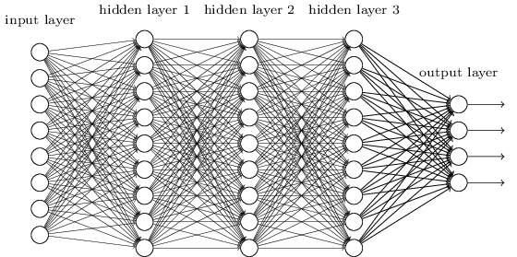
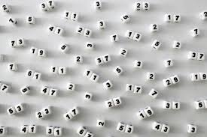

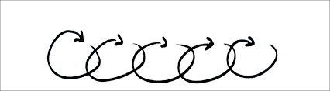
1. Learning Algorithm
Learning
Stochastic gradient descent , SGD( four steps )
1
Mini-batch
2
Descent
Weight
Bias
3
Update weight
4
Iteration
Notes:
여기서 말하는 기울기는 가중치 매개변수에 관한 손실함수의 기울기

Slide 3

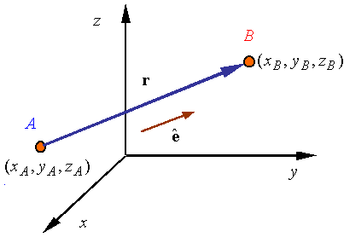
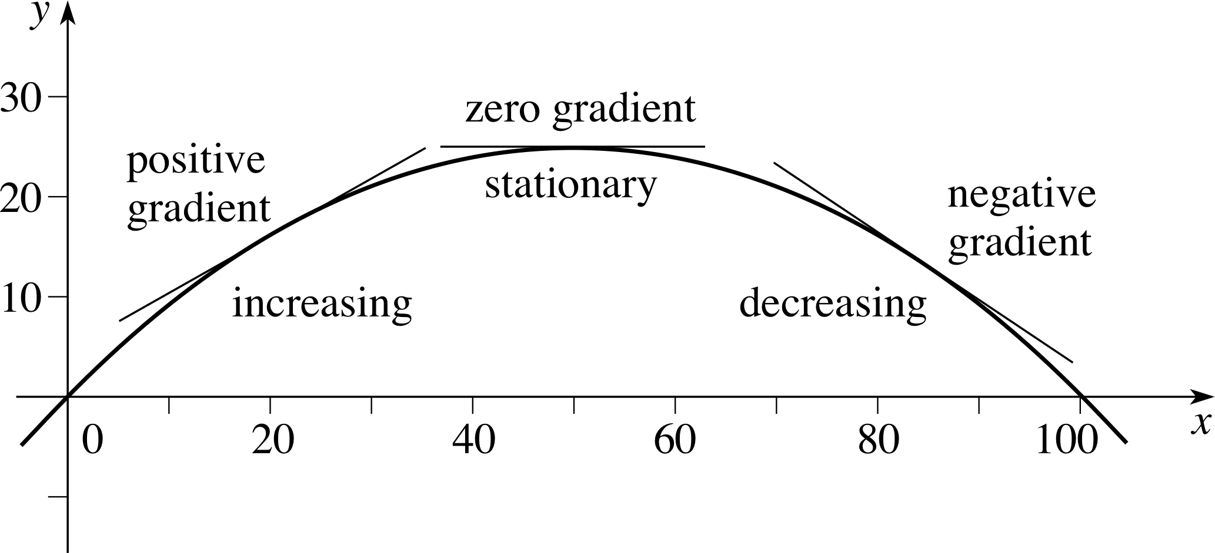
7.Gradient
Two or More than Two Variables??
Gradient
x0
x1
x0 = 3, x1 = 4
(x0, x1)
(df/dx0, df/dx1)

Slide 4
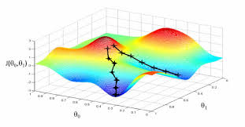
8.Gradient descent method
Machine Learning
Training
Weight
Bias
Deep Learning
Training
Weight
Bias
Gradient descent method
Weight
Bias
Loss

Slide 5
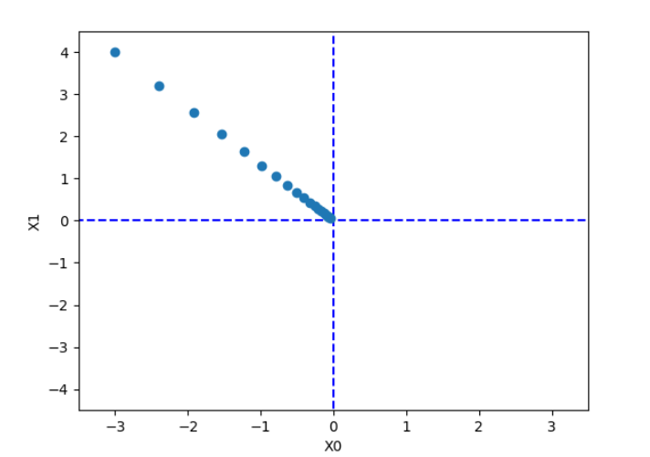
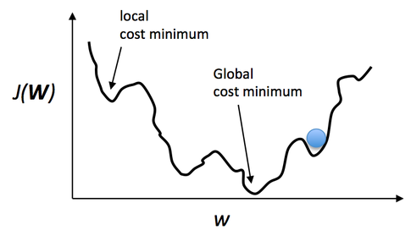
8.Gradient descent method - 2
Learning rate
Gradient method
x0 = x0 - n * df /dx0
x1 = x1 - n * df /dx1
n = learning rate

